Slide 1
Fundamentals of Software Engineering
LECTURE 16: Software Architecture styles

Slide 2
Architectural Styles
An architectural style (also known as an architectural pattern) abstract the common properties of a family of similar designs.
Define a family of systems in terms of a pattern of its structural organization.

Slide 3
Components of a style
The key components of an architectural styles are:
Elements/components
That perform functions required by a system
Connectors
That enable communication, coordination and cooperation among elements
Constraints
That define how elements can be integrated to form the system
Attributes
That describe the advantages and disadvantages of the chosen structure

Slide 4
Categories of Architectural Styles
Hierarchal Software Architecture
Layered
Distributed Software architecture
Clint Server
SOA
Data flow Software Architecture
Pipe n filter
Batch Sequential

Slide 5
Categories of Architectural Styles
Event Based Software Architectural
Data Centered Software Architecture
Black box
Shared Repository
Interaction Oriented Software Architecture
Modal View Controller
Component-based Software Architecture

Slide 6
Hierarchal Style
The hierarchical Software architecture is characterized by viewing the entire system as a hierarchy structure

Slide 7
Hierarchal Style
Modules at different levels are connected by explicit or implicit method invocations.
A lower level module provides services to its adjacent upper level modules, which invokes the methods or procedures in the lower level.

Slide 8
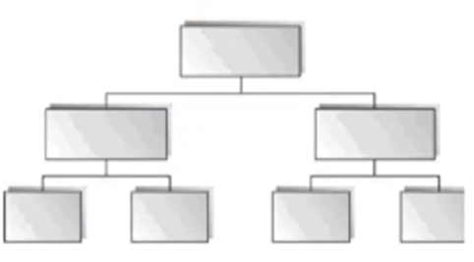
Hierarchal Style

Slide 9
Hierarchal Style
System software is typically designed using the hierarchical Style

Slide 10
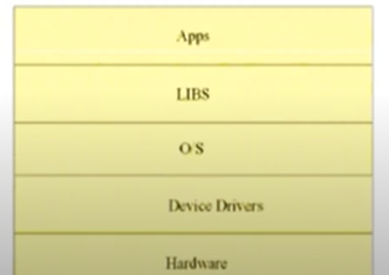
Hierarchal Style

Slide 11
Hierarchal Style
Lower levels provide more specific functionality down to fundamental utility services
Such as I/O services, transaction, scheduling and security services etc.
Middle layers in an application setting, provide more domain dependent functions
Upper layers provide more abstract functionality in the form of user interfaces

Slide 12
Layered Style
Organized hierarchically into layers,
Each layer provides service to the layer above it and services as a client to the layer below
The connectors are defined by the protocols that determine how the layers will interact

Slide 13
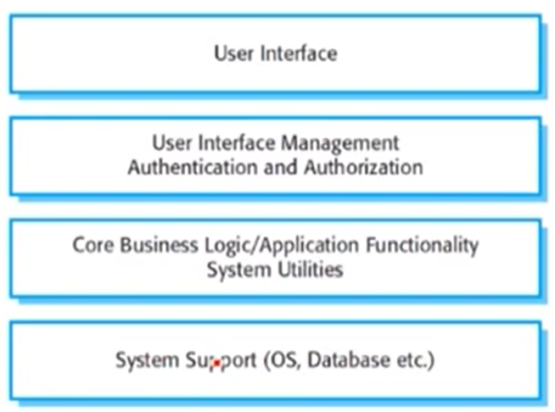
A generic Layered Architecture

Slide 14
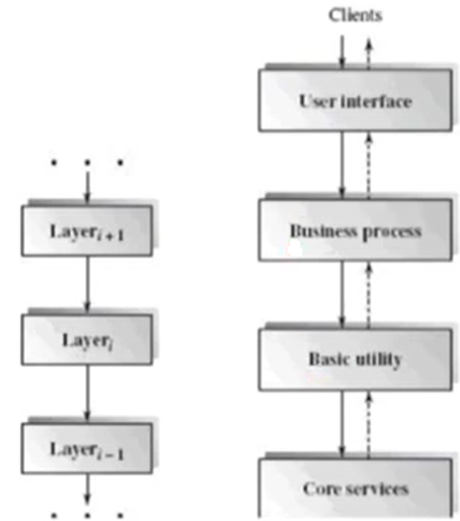
A layered architectural example

Slide 15
Specializations
Often exception are made to permit non adjacent layers to communicate directly.
This is usually done for efficiency reasons

Slide 16
Example:
Library system
Allows controlled electronic access to copyright material from a group of university libraries.
Bottom layer being the individual database in each library.

Slide 17
Example:
Components
UI
Authentication and forms
Search engine
Document retrieval
Rights manager
Accounts management
databases

Slide 18
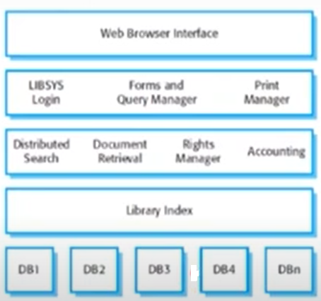
Example: Library system

Slide 19
Applicable domains of layered architecture
Any system that can be divided between the application specific portions and platform specific portions which provide generic services to the application of the system
Application that have clean divisions between core services, critical services, user interface services, etc.

Slide 20
Applicable domains of layered architecture
Applications that have number of classes that are closely related to each other so that they can be grouped together into a package to provide services to others.

Slide 21
benefits
Incremental software development based on increasing levels of abstraction
Enhanced independence of upper layer to lower layer since there is no impact from the changes of lower layer services as long as their interfaces remain unchanged.

Slide 22
Limitations
Lower runtime performance since a clients request or a response to a client must go through potentially several layers
There are also performance concerns of overhead on the data processing and buffering by each layer
Many applications cannot fit this architecture design

Slide 23
Limitations
Breach of interlayer communication may cause deadlocks and bridging may cause tight coupling

